Slide 1


How to Search for a Policy in Medworxx
PDMS 5

Slide 2

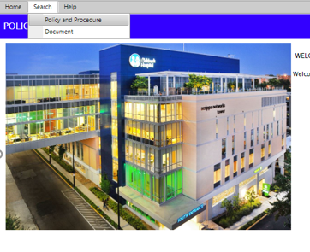
How to Search
Hover over Search
Click on Policy and Procedure

Slide 3
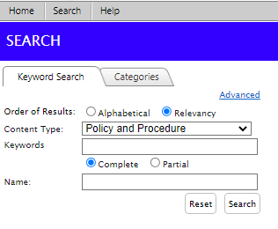
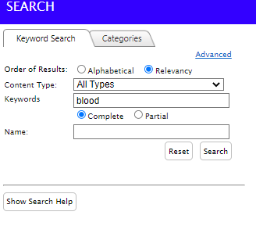
How to Search
Click on Relevancy
Click in Keywords box
Search will be listed Alphabetically unless Relevancy is selected.
Type in one or more keywords or one or more words from the policy name in the Keywords Box (i.e. blood as per below) and click Search

Slide 4
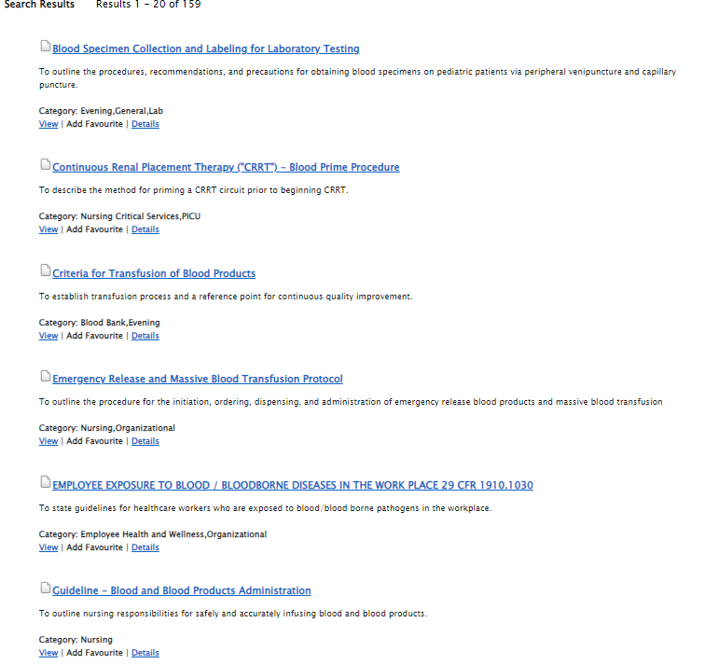
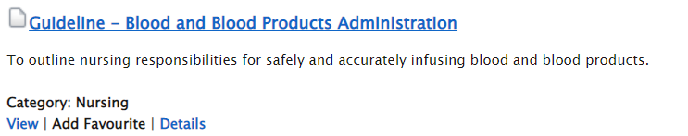
How to Search
Look for desired policy
Click on the Title in blue to view the policy
You may have to scroll down or even go to the following pages to find the desired policy

